Slide 1
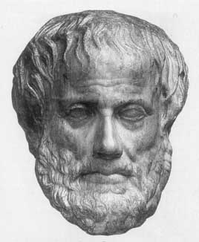
Lecture 6: Game Playing
Junfeng Yao
Xiamen University
Slides used in the classroom only

Slide 2
Lecture overview
Chapter 6: Adversarial(对抗性 ) search in Russell and Norvig
  What is a game?
  Optimal strategies – Minimax algorithm
  Alpha-Beta Pruning
  Expectiminimax Value

Slide 3
What is a game?
A game can be formally defined as a kind of search problem with the following components:
  The initial state, which includes the board position and identifies the player to move.
  A successor function, which returns a list of (move, state) pairs, each indicating a legal move and the resulting state.
  A terminal test, which determines when the game is over. States where the game has ended are called terminal states.
  A utility function (also called an objective function or payoff function), which gives a numeric value for the terminal states.

Slide 4
Two Player Games
Competitive rather than cooperative
  One player loses, one player wins
Zero sum game
  One player wins what the other one loses
  See game theory for the mathematics
Getting an agent to play a game
  Boils down(归结) to how it plays each move
  Express this as a search problem
    Cannot backtrack(回溯 ) once a move has been made (episodic)

Slide 5
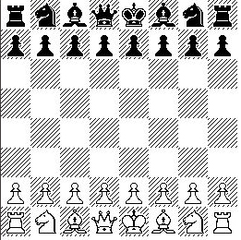
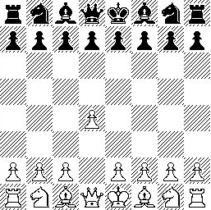
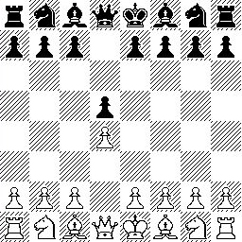
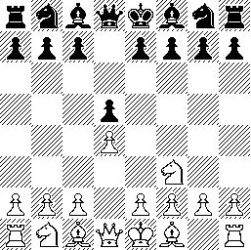
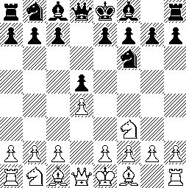
(Our) Basis of Game Playing:
Search for best move every time
Search for Opponent
Move 1 Moves
Initial Board State Board State 2 Board State 3
Search for Opponent
Move 3 Moves
Board State 4 Board State 5

Slide 6
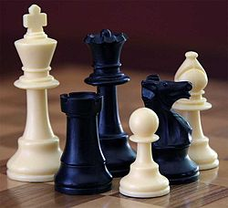
Chess
From left, a white king(王), black rook(车) and queen(后), white pawn(卒), black knight(骑士), and white bishop(主教)

Slide 7
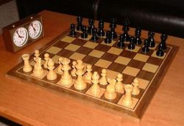
Chess …
64 squares chessboard

Slide 8
Chess …
The game is played on a square chequered chessboard with 64 squares arranged in an eight-by-eight square.
At the start, each player (one controlling the white pieces, the other controlling the black pieces) controls sixteen pieces: one king, one queen, two rooks, two knights, two bishops, and eight pawns.
The object of the game is to checkmate the opponent's king, whereby the king is under immediate attack (in "check") and there is no way to remove it from attack on the next move.

Slide 9
Each chess piece has its own style of moving
The king can move only one square horizontally, vertically, or diagonally. Once in every game, each king is allowed to make a special move, known as castling(王车易位 ). Castling consists of moving the king two squares towards a rook, then placing the rook immediately on the far side of the king. Castling is only permissible if all of the following conditions hold:[1]
The player must never have moved either the king or the rook involved in castling;
There must be no pieces between the king and the rook;
The king may not currently be in check, nor may the king pass through squares that are under attack by enemy pieces. As with any move, castling is illegal if it would place the king in check.
The king and the rook must be on the same rank (to exclude castling with a promoted pawn, described later).

Slide 10
Each chess piece has its own style of moving …
The rook moves any number of vacant squares vertically or horizontally (it is also involved in the king's special move of castling);
The bishop moves any number of vacant squares in any direction diagonally. Note that a bishop never changes square color, therefore players speak about "dark-squared" or "light-squared" bishops, depending on the color of square on which the bishop resides. Alternatively, bishops may be identified as a "queen bishop" or a "king bishop", depending on whether they are next to the queen or the king when on their home square.
The queen can move any number of vacant squares diagonally, horizontally, or vertically;
The knight can jump over occupied squares and moves two spaces horizontally and one space vertically or vice versa, making an "L" shape. A knight in the middle of the board has eight squares to which it can move. Note that every time a knight moves, it changes square color.

Slide 11
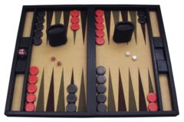
Backgammon(西洋双陆棋，十五子棋 )
Backgammon is a board game for two players in which the playing pieces are moved according to the roll of dice. A player wins by removing all of his checkers from the board. There are many variants(变形) of backgammon, most of which share common traits(特征). Backgammon is a member of the tables family, one of the oldest classes of board games in the world.

Slide 12
Lookahead(向前查找 ) Search
If I played this move
  Then they might play that move
    Then I could do that move
      And they would probably do that move
  Or they might play that move
    Then I could do that move
      And they would play that move
    Or I could play that move
      And they would do that move
If I played this move…

Slide 13
Lookahead Search (best moves)
If I played this move
  Then their best move would be
    Then my best move would be
      Then their best move would be
  Or another good move for them is…
    Then my best move would be
      Etc.

Slide 14
Minimax Search
Underlying assumption
  Opponent acts rationally(理性地)
Each player moves in such a way as to
  Maximise their final winnings, minimise their losses
  i.e., play the best move at the time
Method:
  Calculate the guaranteed final scores for each move
    Assuming the opponent will try to minimise that score
  Choose move that maximises this guaranteed score

Slide 15
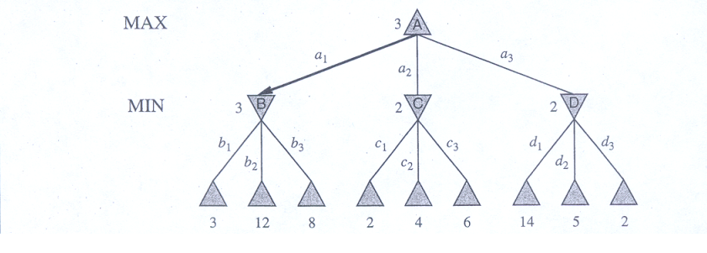
Minimax Search …
Figure 6.2: A two-ply game tree

Slide 16




Example Trivial(小的) Game
Deal four playing cards out, face up
Player 1 chooses one, player 2 chooses one
  Player 1 chooses another, player 2 chooses another
And the winner is….
  Add the cards up
  The player with the highest even number
    Scores that amount (in pounds sterling from opponent)

Slide 17
For Trivial Games
Draw the entire search space
Put the scores associated with each final board state at the ends of the paths
Move the scores from the ends of the paths to the starts of the paths
  Whenever there is a choice use minimax assumption
  This guarantees the scores you can get
Choose the path with the best score at the top
  Take the first move on this path as the next move

Slide 18
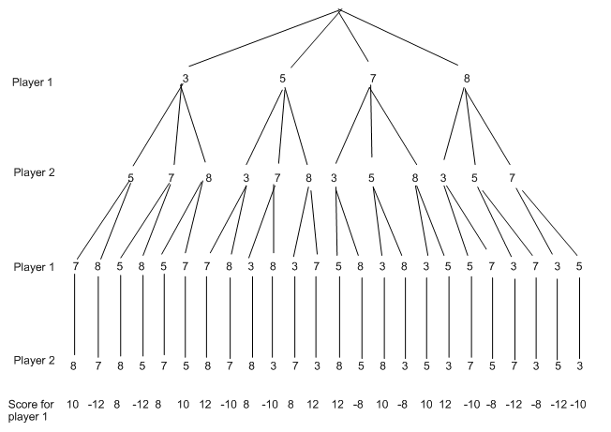
Entire Search Space

Slide 19
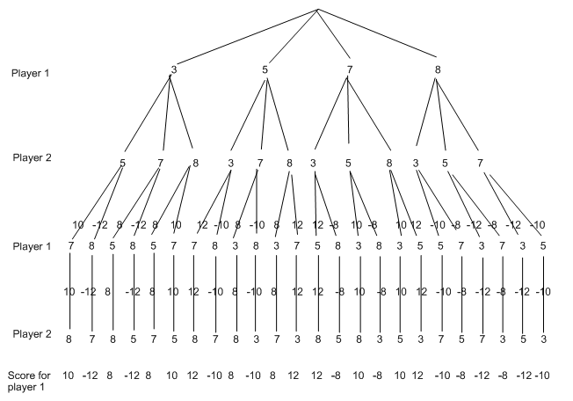
Moving the scores from the bottom to the top

Slide 20
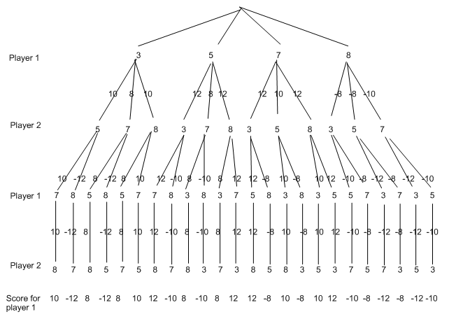
Moving a score when there’s a choice
Use minimax assumption
  Rational choice for the player below the number you’re moving

Slide 21

Choosing the best move

Slide 22
For Real Games
Search space is too large
  So we cannot draw (search) the entire space
For example: chess has branching factor of ~35
  Suppose our agent searches 1000 board states per second
  And has a time limit of 150 seconds
    So can search 150,000 positions per move
  This is only three or four ply look ahead
    Because 35³ = 42,875 and 35⁴ = 1,500,625
  Average humans can look ahead six-eight ply

Slide 23
Cutoff(截止) Search
Must use a heuristic search
Use an evaluation function
  Estimate the guaranteed score from a board state
Draw search space to a certain depth
  Depth chosen to limit the time taken
Put the estimated values at the end of paths
Propagate them to the top as before
Question:
  Is this a uniform path cost, greedy or A* search?

Slide 24
Evaluation Functions
Must be able to differentiate between
  Good and bad board states
  Exact values not important
  Ideally, the function would return the true score
    For goal states
Example in chess
  Weighted linear function
  Weights:
    Pawn=1, knight=bishop=3, rook=5, queen=9

Slide 25
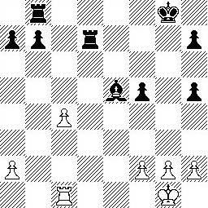
Example Chess Score
Black has:
  5 pawns, 1 bishop, 2 rooks
Score = 1*(5)+3*(1)+5*(2)
= 5+3+10 = 18
White has:
  5 pawns, 1 rook
Score = 1*(5)+5*(1)
= 5 + 5 = 10
Overall scores for this board state: black = 18-10 = 8
white = 10-18 = -8

Slide 26

Evaluation Function for our Game
Evaluation after the first move
  Count zero if it’s odd, take the number if its even
Evaluation function here would choose 10
  But this would be disastrous for the player

Slide 27
Problems with
Evaluation Functions
Horizon problem
  Agent cannot see far enough into search space
    Potentially disastrous board position after seemingly good one
Possible solution
  Reduce the number of initial moves to look at
    Allows you to look further into the search space
Non-quiescent(非静态的) search
  Exhibits big swings(摆动) in the evaluation function
  E.g., when taking pieces in chess
  Solution: advance search past non-quiescent part

Slide 28
Pruning(剪除 )
Want to visit as many board states as possible
  Want to avoid whole branches (prune them)
    Because they can’t possibly lead to a good score
  Example: having your queen taken in chess
    (Queen sacrifices often very good tactic, though)
Alpha-beta pruning
  Can be used for entire search or cutoff(截止) search
  Recognize that a branch cannot produce better score
    Than a node you have already evaluated

Slide 29
Alpha-Beta Pruning for Player 1
Given a node N which can be chosen by player one, then if there is another node, X, along any path, such that
(a) X can be chosen by player two
(b) X is on a higher level than N and
(c) X has been shown to guarantee a worse score for player one than N,
then X can be pruned.

Slide 30
2. Given a node N which can be chosen by player two, then if there is a node X along any path such that
(a) player one can choose X
(b) X is on a higher level than N and
(c) X has been shown to guarantee a better score for player one than N,
then the parent of N can be pruned.

Slide 31
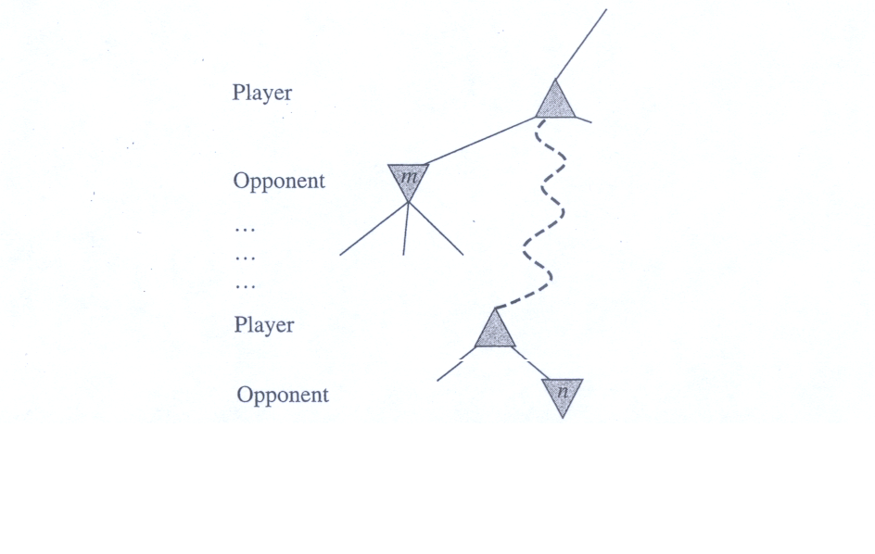
Example of Alpha-Beta Pruning
Figure 6.6: Alpha-Beta pruning: the general case.

Slide 32
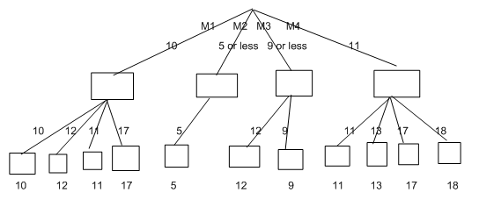
Example of Alpha-Beta Pruning
player 1
Prune
player 2
Depth first search a good idea here
  See notes for explanation

Slide 33
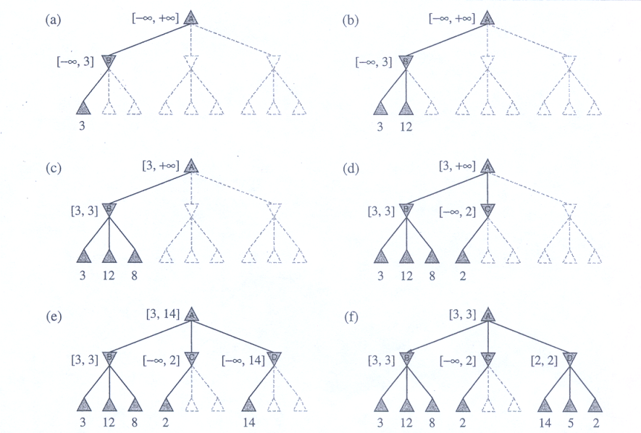
Example of Alpha-Beta Pruning
Figure 6.5: Stages for the game tree using Alpha-Beta pruning

Slide 34
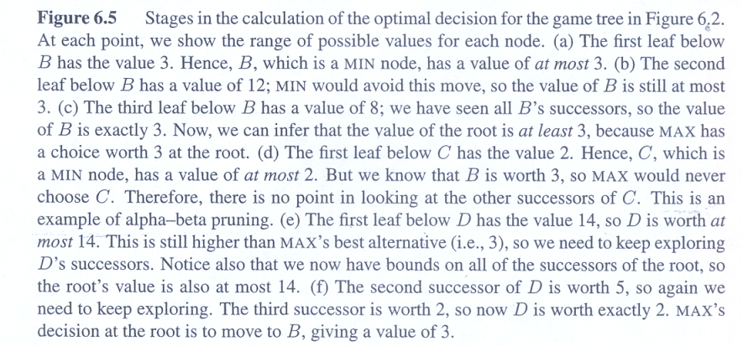
Example of Alpha-Beta Pruning …
Figure 6.5: Stages for the game tree using Alpha-Beta pruning

Slide 35
Alpha and Beta
Alpha – the value of the best (i.e. highest-value) choice we have found so far at any choice point along the path for MAX
Beta - the value of the best (i.e. lowest-value) choice we have found so far at any choice point along the path for MIN

Slide 36
Games with Chance
Many more interesting games
  Have an element of chance
  Brought in by throwing a die, tossing(抛) a coin
Example: backgammon
  See Gerry Tesauro’s TD-Gammon program
In these cases
  We can no longer calculate guaranteed scores
  We can only calculate expected scores
    Using probability to guide us

Slide 37
Expectimax Search
Going to draw tree and move values as before
Whenever there is a random event
  E.g., six extra nodes if each roll of die affects state
  Add an extra node for each possible outcome which will change the board states possible after the event
Work out all possible board states from chance node
When moving score values up through a chance node
  Multiply the value by the probability of the event happening
Add together all the multiplicands
  Gives you expected value coming through the chance node

Slide 38
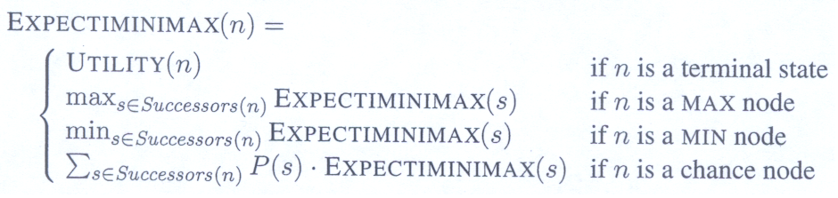
Expectimax Search …
where the successor function for a chance node n simply augments the state of n with each possible dice roll to produce each successor s and P(s) is the probability that that dice roll occurs.
These equations can be backed up recursively all the way to the root of the tree, just as in minimax.

Slide 39
More interesting
(but still trivial) game
Deal four cards face up
Player 1 chooses a card
Player 2 throws a die
  If it’s a six, player 2 chooses a card, swaps it with player 1’s and keeps player 1’s card
  If it’s not a six, player 2 just chooses a card
Player 1 chooses next card
Player 2 takes the last card

Slide 40
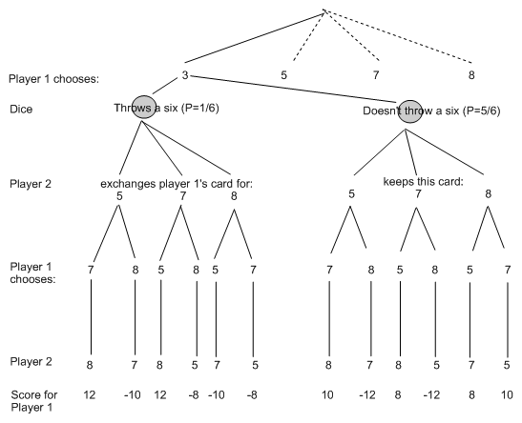
Expectimax Diagram

Slide 41
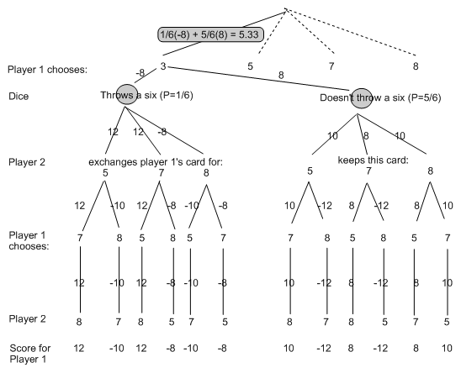
Expectimax Calculations

Slide 42
Games Played by Computer
Games played perfectly:
  Connect four, noughts & crosses (tic-tac-toe)
  Best move pre-calculated for each board state
    Small number of possible board states
Games played well:
  Chess国际象棋, draughts国际跳棋 (checkers跳棋), backgammon双陆棋
  Scrabble拼字游戏, tetris俄罗斯方块(using ANNs)
Games played badly:
  Go, bridge, soccer

Slide 43
Philosophical Questions
Q1. how computers plays chess
  More fundamental than how people play chess?
In science, simple & effective techniques are valued
  Minimax cutoff search is simple and effective
  But this is seen by some as stupid and “non-AI”
Drew McDermott:
  "Saying Deep Blue doesn't really think about chess is like saying an airplane doesn't really fly because it doesn't flap its wings”
Q2. If aliens came to Earth and challenged us to chess…
  Would you send Deep Blue or Kasparov into battle?

Slide 44
Chapter Summary
A game can be defined by the initial state (how the board is set up), the legal actions in each state, a terminal test (which says when the game is over), and a utility function that applies to terminal states.
In two-player zero-sum games with perfect information, the minimax algorithm can select optimal moves using a depth-first enumeration of the game tree.
The alpha-beta search algorithm computes the same optimal move as minimax, but achieves much greater efficiency by eliminating subtrees that are provably irrelevant.
Usually, it is not feasible to consider the whole game tree (even with alpha-beta), so we need to cut the search off at some point and apply an evaluation function that gives an estimate of the utility of a state.

Slide 45
Chapter Summary …
Games of chance can be handled by an extension to the minimax algorithm that evaluates a chance node by taking the average utility of all its children nodes, weighted by the probability of each child.
Optimal play in games of imperfect information, such as bridge, requires reasoning about the current and future belief states of each player. A simple approximation can be obtained by averaging the value of an action over each possible configuration of missing information.
Programs can match or beat the best human players in checkers, Othello, and backgammon and are close behind in bridge. A program has beaten the world chess champion in one exhibition match. Programs remain at the amateur level in Go.

Slide 46


Questions & Suggestions?
The End

